Slide 1

Sentiment Analysis on Amazon Product Reviews
By, Naufiya Rasheed

Slide 2
Project Goal
Analyze product reviews
Classify sentiment: positive or negative
Gain insights from customer feedback

Slide 3
Data Preparation
Loaded 100,000+ reviews
Cleaned text: removed stopwords, punctuation
Applied stemming

Slide 4
Modeling
Built classification model with Python (scikit-learn)
Achieved 91% accuracy
Evaluated with precision, recall, F1-score

Slide 5
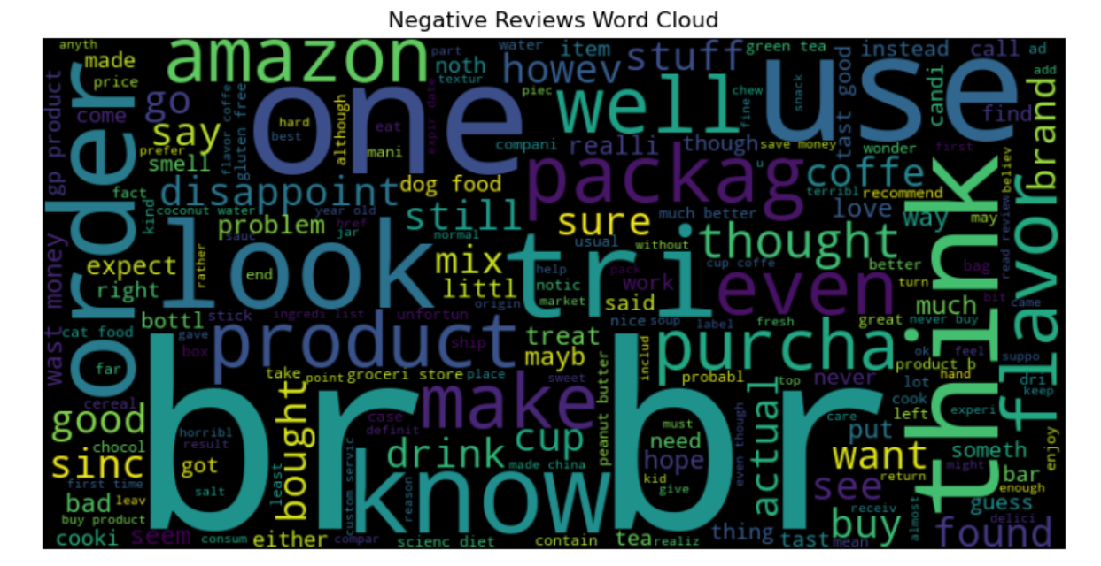
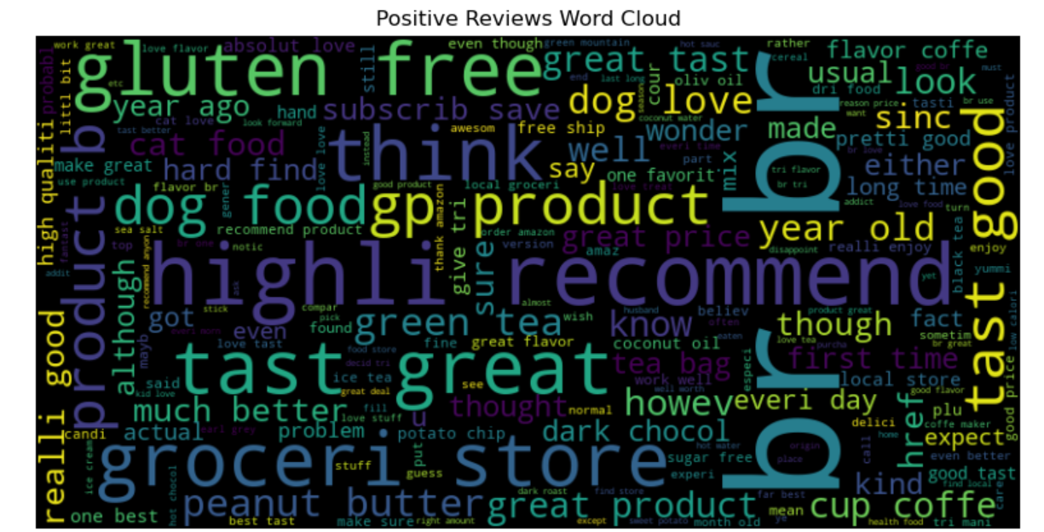
Results – Word Clouds
Visualize frequent words for each sentiment

Slide 6
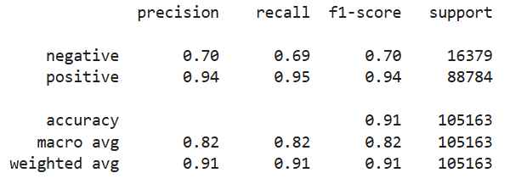
Results – Confusion Matrix
Shows strengths and weaknesses of the model

Slide 7
Conclusion & Next Steps
This project gave me hands-on experience in using Python and NLP to extract meaning from unstructured text data. The sentiment classifier performed exceptionally well in identifying positive reviews — with an F1-score of 0.94 — reflecting clear signals in customer praise.
However, the model struggled more with detecting negative reviews. This revealed an important insight: negative feedback is often more subtle and varied in language, and may require deeper feature extraction and better data balance.
Moving forward, I plan to:
Explore TF-IDF vectorization for better text representation
Use resampling methods to balance the positive and negative classes
Experiment with advanced models like SVM and Logistic Regression

Slide 8

Thank you

